Slide 1
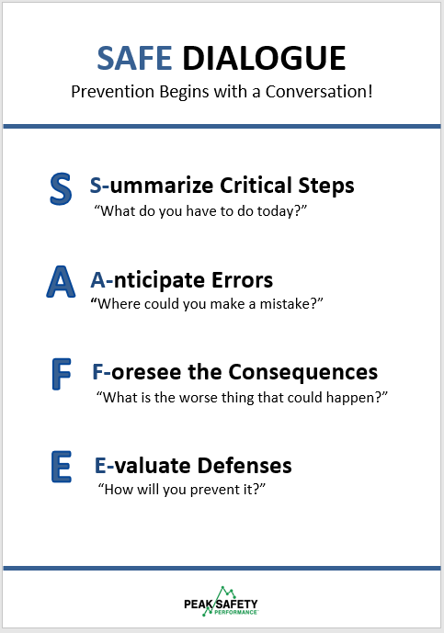
SAFE DIALOGUE
Prevention Begins with a Conversation
The SAFE DIALOGUE provides people with a method to generate useful discussions about safety.
Ask the following questions:
What are the critical steps of the job?
What errors can you anticipate?
What is the worse thing that can happen?
How do you do you protect yourself?
Describe the benefit of using the SAFE DIALOGUE. Provide examples.

