Slide 1
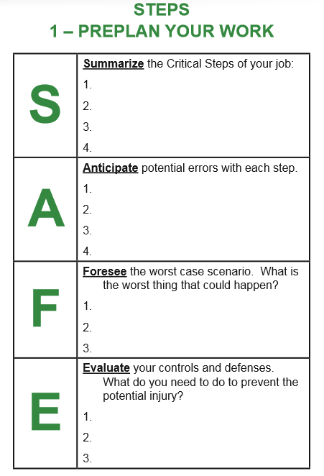
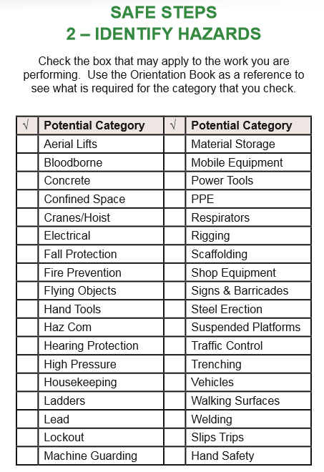
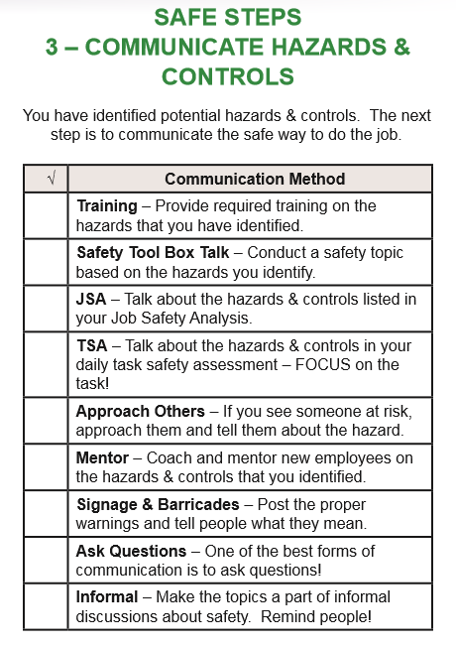
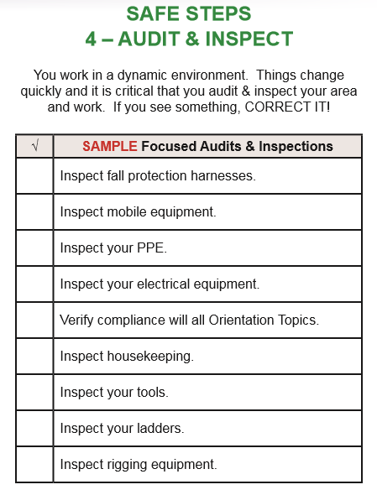
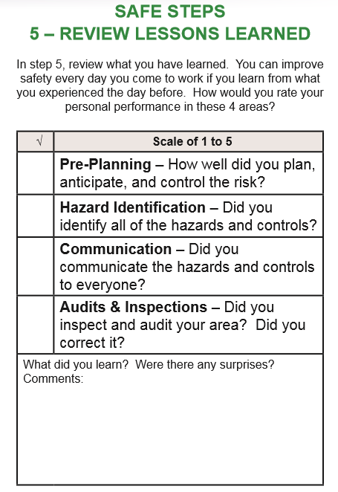
5 Steps to Safety Success
1 - Pre-Plan Your Steps
2 –Identify Hazards
3 – Communicate Hazards
4 – Audit & Inspect
5 – Lessons Learned

